Slide 1


Section 83E RD2
Energy Storage Procurement
Bidders Conference
August 13, 2026
2:00PM - 3:30PM

Slide 2
Today’s Bidder Conference
The requirements, criteria, processes, and all other aspects of this solicitation are governed by the document titled Request For Proposals for Long-Term Contracts For Energy Storage Projects Round 2, issued on July 31, 2026.
This Bidders Conference presentation is:
  Provided for discussion purposes only and may not provide authoritative guidance regarding the solicitation
Official responses will be provided to all stakeholders in writing for questions submitted by Prospective Bidders by August 20, 2026 to MARFP83E@gmail.com.
  Questions submitted by Prospective Bidders after this date will be responded to on a best-effort basis
Notes:
Mike

Slide 3
Representatives at Today’s Conference
Department of Energy Resources (DOER): Joanna Troy, Tom Ferguson
Massachusetts Electric Distribution Companies (EDCs):
  Eversource: Mike McNulty
  National Grid: Adam Crary
  Unitil: Lisa Glover
Notes:
Mike to kick off

Slide 4
Today’s Agenda
Introduction from DOER Deputy Commissioner Troy
Presentation of the RFP: Team Composition and Background
RFP Summary and Key Highlights
Changes from prior RFP
Q&A
Presentation on Procurement Best Practices and CPS: Joanna Troy and Tom Ferguson
A copy of this presentation will be posted on macleanenergy.com
Notes:
Joanna

Slide 5
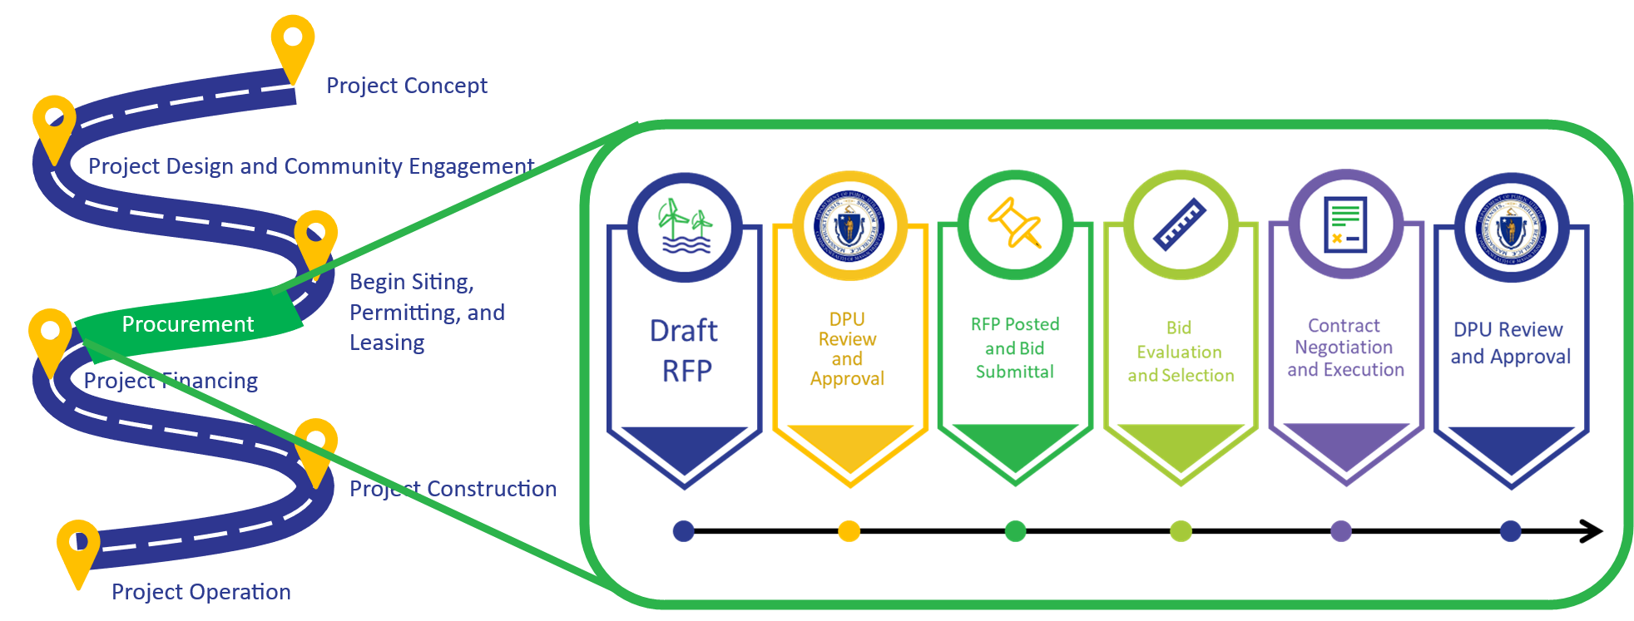
Massachusetts Procurement Overview
Notes:
Joanna

Slide 6
RFP Team Composition
RFP Drafting Team – DOER, EDCs, and the Attorney General’s Office (AGO) in consultation with the Independent Evaluator (IE)
Evaluation Team – DOER, EDCs, and the Executive Office of Economic Development (EOED) in consultation with the IE
Evaluation Team Consultant – Entity or entities that will contract with the EDCs and DOER to assist the Evaluation Team with the technical methodologies, analysis, and findings for eligible proposals
  EDCs have jointly selected Apex Analytics
  DOER has selected Energy and Environmental Economics (E3)
Independent Evaluator (IE) – As required by Section 83E, the IE will monitor and report on the solicitation and bid selection process to ensure the proceedings are open, fair and transparent
  DOER and Attorney General have jointly selected Power Advisory LLC
  Selection Team – DOER in consultation with the IE
  Contracting Parties – EDCs
  DOER, at its discretion, may request the IE to monitor contract negotiations between the EDC’s and the winning bidder(s).
Notes:
Joanna

Slide 7
Background
Round 2 RFP for energy storage projects under 83E of Chapter 169 of the Acts of 2008, as amended by An Act Promoting A Clean Energy Grid, Advancing Equity and Protecting Ratepayers (Chapter 239 of the Acts of 2024).
RFP Drafting Process
  Stakeholder input for Distribution-connection projects requested by the RFP Drafting Team in September 2025 and July 2026
  Stakeholder input for all projects requested by the RFP Drafting Team in January 2026
  Attorney General consulted on solicitation method
  IE monitored and reported on solicitation process
DOER filed draft RFP to Massachusetts Department of Public Utilities (DPU) on May 8, 2026
DPU authorized RFP on July 27, 2026
RFP issued on July 31, 2026
Notes:
Adam

Slide 8
Changes to RFP for Round 2
Procurement target for 1,000 MW total vs. 1,500 MW in Rd. 1
Distribution Project procurement target between 250-300 MW
Project size – 40 MW to 700 MW for Tx (& phases), >1 MW for Dx
Commercial Operation Date Deadline extended to 12/31/2032
Evaluation Criteria Weighting change; 80/20 to 75/25
Evaluation will place significant focus on project maturity, interconnection status, site control
Awarded Distribution Projects will receive non-negotiable Terms and Conditions
More targeted focus on ITC eligibility, FEOC, supply chain
Expanded Reliability and Community Benefit focus
Eligibility for Surplus Interconnection Service (SIS) projects
Notes:
Adam

Slide 9
Summary of 83E Round 2
  Solicitation Target, Allowable Bid Size and COD requirements (1.1 & 2.2.1.1 & 2.2.1.2 of RFP)
  The Round 2 procurement is for the Environmental Attributes (including CPECs) generated by up to 1,000 MW of capacity of Mid-Duration Storage Systems
  Capable of dispatching energy at its full rated capacity for a period up to or greater than 4 hours and up to 10 hours.
  Full rated capacity defined as the actual nameplate capacity, as built, and certified by independent engineer.
  Allowable proposal sizes range from 40 MW to 700 MW for transmission-connected proposals and greater than 1 MW for distribution-connected proposals. Up to 2 phases of development are allowed for transmission-connected proposal, at a minimum of 100 MW per phase.
  All proposals must provide a scheduled commercial operation date (COD) on or before December 31, 2032
  Existing resources that meet all other eligibility criteria are eligible to bid
Notes:
Lisa

Slide 10
Summary of 83E Round 2 (continued)
Interconnection requirements (2.2.1.2 & 2.2.1.6 & 2.2.1.8 of RFP)
All transmission-level proposals must have a valid Interconnection Request or commitment to submit an Interconnection Request into the next available ISO-NE Cluster Study. Such Interconnection Request must be to interconnect to the ISO-NE Pool Transmission Facilities (“PTF”) at a level equivalent to the Capacity Capability Interconnection Standard*, as defined by ISO-NE.
  *Exception being a commitment to interconnect to the ISO-NE PTF at the Network Resource Interconnection Standard, as defined by ISO-NE, as part of a Surplus Interconnection Service arrangement. The Original Interconnection Customer must be currently receiving Capacity Network Resource Interconnection Service.
All distribution-level proposals must
  Have an active interconnection application with the relevant Distribution Company
  Take the steps outlined in the ISO-NE tariff to screen for and, if applicable, establish equivalent Capacity Network Resource Capability (eCNRC), as defined in the ISO-NE.
  Enroll in the Operational Parameters for Energy Storage Systems (OPESS) Tariff offered by the interconnecting utility (“Distribution ESS Tariffs”) once such tariffs become effective.
Notes:
Mike

Slide 11
Pricing Requirements
Proposals for CPECs must be priced on an annual $/CPEC basis.
Prices may be the same each year, include a one-time step down to account for the Alternative Compliance Payment (ACP) decrease from 2032 to 2033, or change by a defined rate or amount over time.
In no single year over the life of the long-term contract can the $/CPEC price be higher than 97.75% of the CPEC ACP, which is $65 for Compliance Years 2026 through 2032, and $45 thereafter.
For any multi-phased transmission proposal, the nominal levelized price per CPEC must be the same across both phases.
While the Rd. 2 procurement is for Environmental Attributes only, bidders should complete the Hourly Storage Energy Flow section of the CPPD Form, Part 5 (a), in a manner that reflects anticipated balance of all potential revenue streams
Notes:
Lisa

Slide 12
Bid Submittal
ShareFile Upload
  By August 21, 2026, submit an email to marfp83E@gmail.com requesting a bid-specific ShareFile URL to use to submit both the confidential and public bid packages. Each bidder will receive a unique ShareFile URL that will only be accessible for viewing and downloading by members of the Evaluation Team and the IE.
  It is the responsibility of the bidder to ensure that it does not publicly disseminate its unique ShareFile URL.
  Both the Public and Confidential Versions of all bids must be uploaded to the bid-specific ShareFile URL by 12:00 p.m. EDT on September 10, 2026. In order to be considered, all bid fees must be received by this deadline as well. Materials cannot be changed or submitted after the bid deadline. Any changes must be communicated as bid updates.
12
Notes:
Lisa Dx and Tx will be different

Slide 13
Non-refundable Bid Fees (1.10 and 2.2.1.13 of RFP)
Non-refundable Bid Fees
The bid fee will be $500 per MW based on the Full Rated Capacity of the bid. If a bid is for a portion of the capacity from a storage facility, then the bid fee will be calculated based on the Full Rated Capacity of the portion of the facility included in the bid.
Each bid, even if the bid is a variation of another bid, will be subject to the same $500 per MW non-refundable bid fee.
Notes:
Lisa

Slide 14
Evaluation Process
Stage 1 (2.2 of RFP)
  Proposals will be reviewed to ensure that they meet eligibility (2.2.1 of RFP) and threshold (2.2.2 of RFP) requirements.
Stage 2 (2.3 of RFP)
  Proposals will be evaluated based on specified quantitative (2.4 of RFP) and qualitative (2.6 of RFP) criteria.
Stage 3 (2.7 of RFP)
  Further evaluation of remaining proposals to ensure selection of proposal(s) which provide the greatest impact and value.
Evaluation Team reserves the right, at any stage, to disqualify and eliminate from further consideration any proposal that it reasonably believes does not meet the requirements.
Notes:
Tom

Slide 15
Qualitative
Benefits to Environmental Justice & Low Income Communities
Economic Benefits to Transitioning Fossil Fuel Communities
Reliability Benefits, Grid Resiliency, Locational Benefits
Safety Plan
Community & Stakeholder Engagement
Impacts from Siting – Environmental, Socioeconomic, Environmental Justice and host communities
Experience & Track Record of the Bidder
Siting, Permitting, Project Schedule, and Financing Plan
Contract Risk*
  *Does not apply to distribution projects, see next slide
Notes:
Tom

Slide 16
Contracting (2.8 of RFP)
Bidders will be notified whether they have been selected to negotiate a contract*; such selection does not accept any mark-ups or guarantee that a contract will be awarded to bidder.
Selected Bidders will enter into separate contracts with each EDC if the negotiations are successful.*
Bidders are not permitted to revise their bids in contract negotiations.
Bidders are responsible for satisfying all local, state and federal requirements, and making all necessary filings and submissions to obtain all approvals for their projects.
Each bidder will be responsible for posting 100% of their development period security with the EDCs at contract execution.
*Awarded Distribution Project bids will receive non-negotiable terms and conditions
Notes:
Adam

Slide 17
Anticipated Schedule (3.1 of RFP)
Event | Anticipated Date(s)
Issue RFP | July 31, 2026
Bidders Conference | August 13, 2026
Deadline for Submission of Questions | August 20, 2026
Due Date for Submission of Confidential and Public Proposals | September 10, 2026
Selection of Projects/Commence Negotiation | January 27, 2027
Execute Long Term Contracts and MOU with DOER | April 28, 2027
Submit Long Term Contracts for DPU Approval | May 26, 2027
Please be advised that a ShareFile URL must be requested no later than August 21, 2026
Notes:
Adam not after noon

Slide 18
RFP Clarifications
Delivery Requirement (2.2.1.7)
  Must provide a planned Environmental Attribute delivery schedule for the number anticipated delivering on a monthly basis, which will be used for evaluation purposes.
  The Long-Term Contract states Seller shall deliver up to the Contract Maximum Amount. There is no minimum monthly delivery requirement, but failure to deliver for 12 consecutive months constitutes a default by seller.
Round-Trip Efficiency (CPPD, Appendix A-3)
  Definition: For energy storage systems, the ratio of energy output during discharge to the energy input during charging, as rated by the equipment manufacturer
  Bidders will be required to include monthly adjustment factors as a percentage of expected production throughout the term of their proposed contract in their CPPD Form and explain their degradation mitigation plan, if applicable, in Appendix A 3.11.
Notes:
Lisa

Slide 19
Today’s Q&A Protocol
Purpose of Q&A is to assist bidders in preparing bids.
All answers provided at this forum are for information only.
Official responses will be provided in writing to the questions submitted to MARFP83E@gmail.com.
To ask a question:
  Please use the “raise hand” function
  The host will call on you
  Please announce your name and the entity you represent before asking your question
Panelists will attempt to answer questions but may call on other members of the team to assist.
A copy of this presentation will be posted on macleanenergy.com
Notes:
Mike

Slide 20
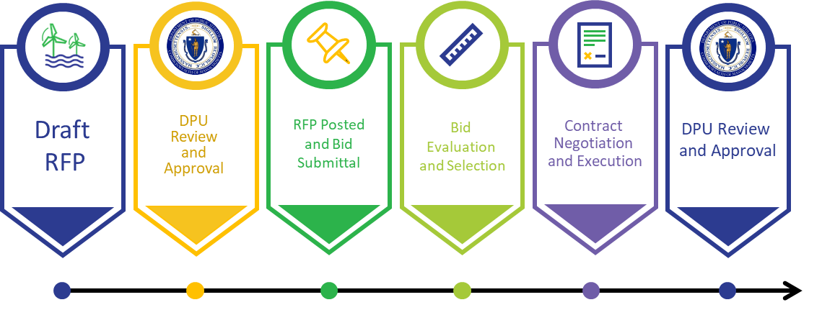
DOER – Overview of Procurements
The following information is provided for informational purposes only and should not be considered RFP language

Slide 21
Section 83E - Targets
“In order to provide a cost-effective mechanism for facilitating the financing of beneficial, reliable energy storage systems”
Approximately 5,000 megawatts of energy storage systems not later than July 31, 2030, of which:
  3,500 megawatts shall be mid-duration energy storage (4-10 hr. duration),
  750 megawatts shall be long-duration energy storage and, if commercially available at a reasonable cost (10+ - 24 hr. duration),
  750 megawatts shall be multi-day energy storage; provided, however, that existing energy storage systems shall be eligible to participate in any procurement issued under this section (24+ hr. duration).
5,000 MW
750 MW
Multi-Day
Storage
750 MW
Long-Duration
Storage
3,500 MW
Mid-Duration
Storage

Slide 22
Overall 83E Procurement Schedule
(i) approximately 1,500 megawatts of mid-duration storage shall be procured by July 31, 2025, and shall be for environmental attributes only;
(ii) approximately 1,000 megawatts of mid-duration storage shall be procured by July 31, 2026;
(iii) approximately 1,000 megawatts of mid-duration storage shall be procured by July 31, 2027; and
(iv) all remaining energy storage systems capacity shall be procured by July 31, 2030. Each procurement shall consider inclusion of environmental attributes, energy services or a combination of both; provided, however, that the procurement of 1,500 megawatts of mid-duration storage by July 31, 2025 shall be for environmental attributes only.
ROUND 1
July 31, 2025
1,500 MW Mid-Duration (4-10 hr.)
Environmental Attributes
ROUND 3
July 31, 2027
1,000 MW Mid-Duration (4-10 hr.)
Environmental Attributes and/or
Energy Services
July 31, 2030
All Remaining:
750 MW Long Duration (10+ - 24 hr.)
750 MW Multi Day (24+ hr.)
ROUND 2
July 31, 2026
1,000 MW Mid-Duration (4-10 hr.)
Environmental Attributes and/or
Energy Services

Slide 23
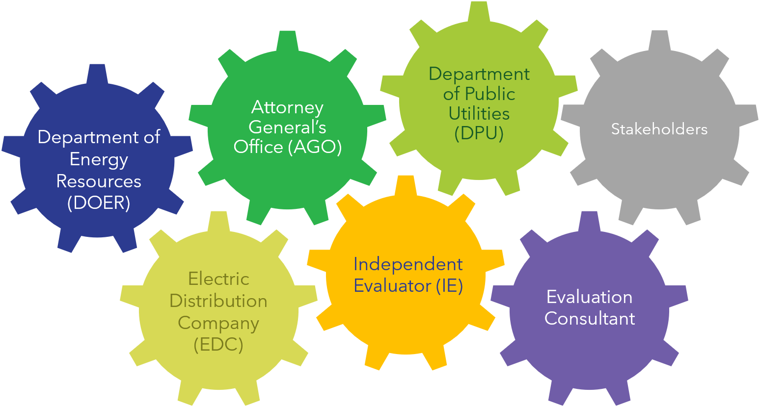
Key Procurement Partners

Slide 24
Key Process Documents
RFP
Protocols
Bid Package
Evaluation
Contracts
DPU Review and Approval

Slide 25
The Bid Package
The bid package is the bidder’s proposal for project selection and contracting
Submit all requested materials in complete form.
Complete all Certification, Project, and Pricing Data forms, including all underlying assumptions entirely and as accurately as possible.
While the Evaluation Team must inevitably ask clarifying questions to bidders, minimizing the need for these questions is optimal.
  Responses to bidder questions are considered part of the bid package

Slide 26
Previous Procurements
DPU Dockets for: | RFP Review and Approval | Contracts
83 | 10-76 | 11-05, 11-06, 11-07, 11-12, 11-30, 09-138
83A | 13-57, 15-42 | 13-146/147/148
Multi-State 83A | 15-84 | 17-117/118/119/120
83D | 17-32 | 18-64/65/66, 24-160
83C Round I | 17-103 | 18-76/77/78
83C Round II | 19-45 | 20-16/17/18
83 C Round III | 21-40 | 22-70/71/72
83C Round IV | 23-42 | TBD
83E Round 1 | 25-59 | 26-87/88/89
83E Round 2 | 26-75 | TBD

Slide 27
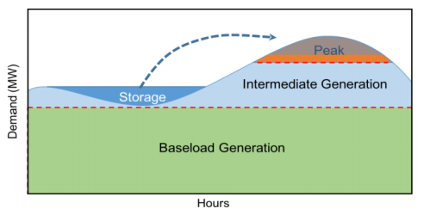
Clean Peak Energy Standard (CPS) Overview
Objective: Reduce cost and emissions impacts of peak demand through renewables, energy storage, and demand response
Mechanism – Market-based
  Eligible resources that generate, dispatch or discharge renewable energy during Seasonal Peak Periods will generate Clean Peak Energy Certificates (CPECs)
  All retail electricity suppliers must annually purchase a certain number of Clean Peak Energy Certificates (CPECs) relative to their load served, called the Minimum Standard
Seasonal Peak Periods – Late afternoon through evening
  Winter (Dec. 1 – Feb. 28): 4pm – 8pm
  Spring (Mar. 1 – May 14): 5pm – 9pm
  Summer (May 15 – Sept. 14): 4pm – 8pm
  Fall (Sept. 15 – Nov. 30): 4pm – 8pm
  CPS is the driving incentive for the deployment of large standalone energy storage systems in the Commonwealth
Notes:
Tom on multipliers

Slide 28
CPS: Program Multipliers
  In CPS, every MWh of Clean Peak Resource (CPR) performance under the program will generate a Clean Peak Energy Certificate (CPEC), the instrument used for CPS compliance. However, CPS has CPEC Multipliers that when applied to a CPR’s performance will increase or decrease the CPECs it generates.
  Most multipliers are common to all CPRs. For example:
    Seasonal: 4x during the Winter and Summer Seasons and 1x during the Spring and Fall Seasons
    Actual Monthly System Peak: 25x for performance coincident with highest single hour of demand in the month within the ISO-NE Control Area
    Existing Resource: 0.1x applied to CPRs with a Commercial Operation Date before January 1, 2019
  However, distribution-connected Qualified Energy Storage Systems (QESS) are eligible for two unique multipliers:
    Distribution Circuit (DCM): 2x, limited to 10 years from qualifying for the CPS. Resources must connect to specific distribution circuits designated by DOER.
      The DCM Guideline, which clarifies eligibility, circuit selection, and the application process: DCM Guideline
      The list of eligible circuits, which DOER updates annually and shows both reserved and remaining capacity per circuit, may be found here: DCM Circuit List
      The DCM Application may be found here: DCM Application
    Near-Term Resource (NTRM): 2x, limited to earlier of 10 years from qualifying for the CPS or December 31, 2036.
      The NTRM program is limited to 50 MW of total QESS capacity and no one company may reserve more than 50% of the program’s total capacity
      The NTRM Guideline, which clarifies eligibility and the application process may be found here: NTRM Guideline.
      The NTRM capacity reservation and waitlist may be found here: NTRM Reservation List
      The NTRM Application may be found here: NTRM Application
    A project may not receive both the DCM and the NTRM.
  Questions? Please email DOER.CPS@mass.gov
Notes:
Tom

Slide 29
CPS: QESS Requirements in SQA
For equipment, manufacturers’ spec sheets (e.g., battery, inverter, etc.)
Permission to Operate (PTO) and/or approved Authorization to Interconnect (ATI)
Requirements by operational eligibility method:
  Co-location. All of the following:
    Manufacturer’s spec sheet for co-located Qualified RPS Resource
    PTO/ATI for co-located Qualified RPS Resource
    System layout or one-line diagram
  Contract-based: Contract between parties
  Charging windows: Attestation and provide ISA with operational schedule
  Resolve power quality: ISA with operational schedule
Full step-by-step application process may be found at DOER’s website, here

