Slide 1





83E Round 1 Comments
March 5, 2025
Energy Storage Coalition
Jupiter Power - Bluewave -
Flatiron - New Leaf Energy
Cypress Creek

Slide 2
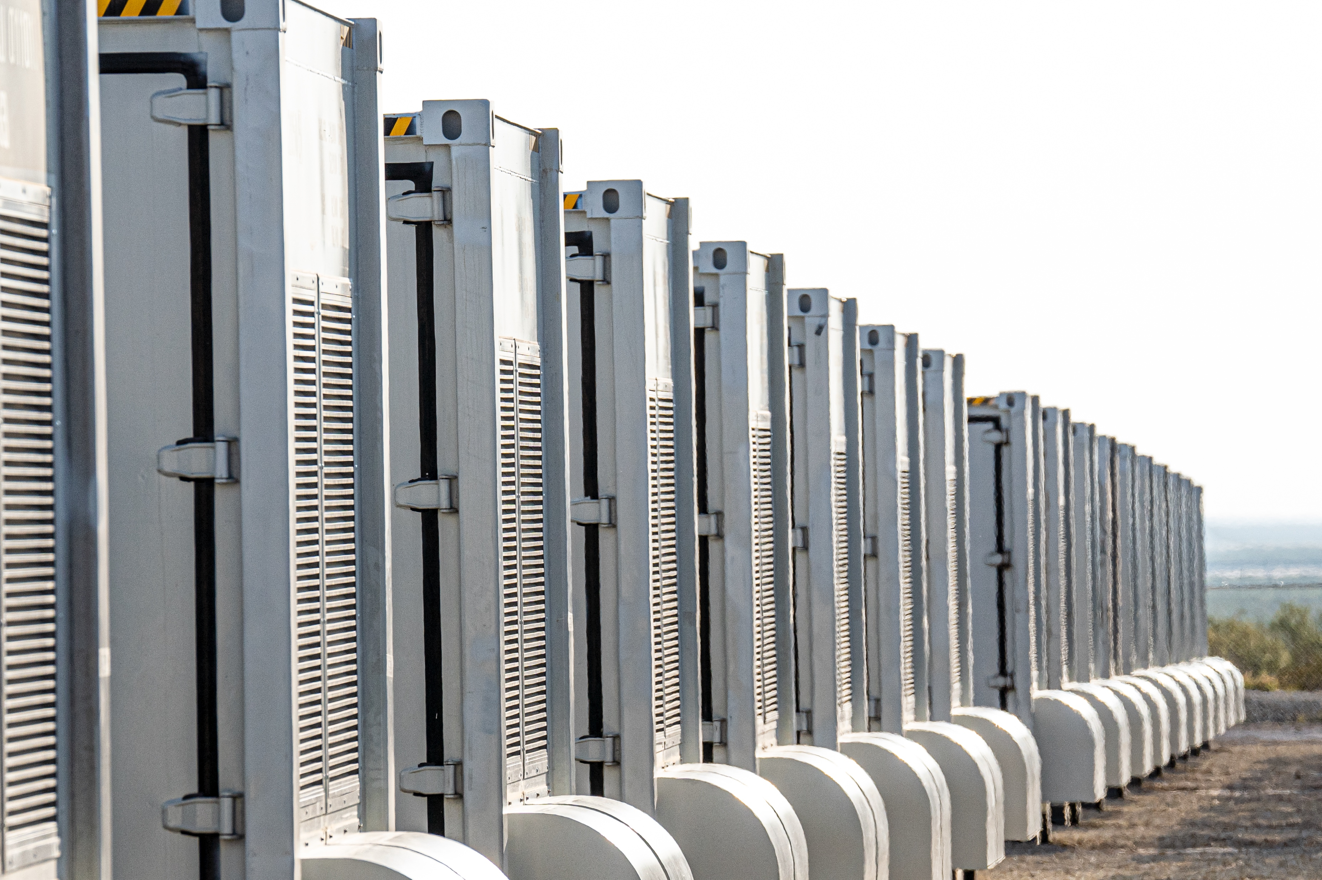
2024 Energy Act – Summary of Key Provisions
Amends the Green Communities Act, Ch. 169 of the Acts of 2008
NEW Sec. 83E – requires DOER to procure 5 GW of storage by 2030
The Act gives DOER guidance on the RFP by outlining a few key criteria that “shall” be included in bid proposals, or for which DOER “may” give preference in selection:
  Supporting grid resiliency and transmission needs in specific geographic locations;
  Providing benefits (including economic opportunities or public health benefits) to environmental justice and/or low-income communities
  Creating economic opportunities in transitioning fossil fuel communities
  Including opportunities for diversity, equity and inclusion
These slides recommend that DOER conduct the 2025 and 2026 procurements through a single RFP for efficiency:
        → 1,500 MW of mid-duration storage by July 2025
        → 1,000 MW of mid-duration storage in 2026
        → both rounds or phases of the initial procurement would be developed under the same RFP and contract structure, but with different bid deadlines
→ both Rounds 1 and 2 would be focused on enviro attributes only (i.e., CPECs from “Qualified Energy Storage Systems” as defined in 225 CMR 21.02)

Slide 3
Policy Goals and 6 Key Recommendations for Initial Storage Procurement
Policy Goals
1
2
3
4
5
6
Expedite Procurement Timing
Long-Term Revenue Certainty
Qualitative Benefits
Project Viability
Reliability and Resilience Benefits
Community Benefits/ Brownfield Transition
DOER submit contracts to DPU from Round 1 process by March 1, 2026;
responses to Round 2 due October 2026
Recommendations
(at least) 15-year Contract Terms
65/35 split on Quantitative vs. Qualitative factors
Additional points for projects advanced in development
Additional points for projects w/ local grid benefits
Additional points for community benefits in key geographies

Slide 4
Policy Goal #1– Expedite procurement timeline to allow shovel-ready projects to get built ahead of 2030
Recommendation – Complete first round DOER-led process for the 1,500 MW (bids, contracts, DPU submission) by March 1, 2026
1,000s of MWs of storage projects are in advanced stages of development in MA – capable of operating by 2030 and essential to support the state’s clean energy transition
Many of these projects have existential financial decisions in 2025/early 2026, putting binding time pressure on procurement schedule (e.g., LGIAs, land closing, capacity market obligations)
Financing must be secured in advance of project construction, which then can take ~2 yrs from securing an award → 27/28 COD projects already on tight timeline
    ***Brownfield projects are desirable but could take > 2 yrs to build, leaving them most vulnerable to procurement delays
Schedule (to right) proposes an expedited—yet feasible—timeline giving shovel-ready projects the confidence to make investments, secure financing, and move to construction ASAP
Round 1 Event | Round 1 Dates
Issue RFP | July 31, 2025 (reflects statutory requirement)
Bidders Conference | August 14, 2025
Deadline for Submission of Questions | August 21, 2025
Due Date for Submission of Confidential and Public Proposals | September 12, 2025 at 12:00 (noon) EDT
Selection of Projects/Commence Negotiations | November 7, 2025
Execute Long Term Contracts and MOU with DOER | January 15, 2026
Submit Long Term Contracts for DPU Approval | February 15, 2026
DPU Approval of Contracts | August 15, 2026 (reflects statutory 6-month approval, at the latest)
Resilience
DOER-led process concludes

Slide 5
Policy Goal #1– Conduct 2nd round of procurement in 2026 to keep momentum on mid-duration storage deployment
Recommendation – Develop a single RFP and contract structure for Rounds 1 and 2 at the same time, and conduct the second phase of bids for 1,000 MW of mid-duration storage in 2026
  Round 2 would meet the intent of Section 83E while minimizing regulatory process and administrative burden:
    Round 2 would use the same RFP with the same requirements and same contract as round 1.
    Round 2 would be for the procurement of CPECs only.
    Round 2 bid submission date should follow DPU approval of Round 1 contracts.
  Round 2 helps ensure a procurement is held in 2026; no procurement in 2026 could lead to projects pulling out of queue and delaying deployment of storage
  Round 2 bid timing and subsequent events should align with ISO-NE cluster study dates to allow for higher quality interconnection cost estimates in the bid

Slide 6
Policy Goal #2 – Ensure long-term revenue certainty and lower financing costs for developers, benefitting ratepayers
Recommendation – Specify at least 15-year contract terms
Until recently, the CPS auction structure had generated an unpredictable revenue stream that was difficult to underwrite, leaving storage projects with access only to limited, high-cost capital → or unable to raise capital at all
New legislative procurement authority changes this dynamic with a requirement for long-term contracts for CPECs
  2024 Energy Act requires distribution companies, in coordination with DOER, to enter into “long-term contracts” for energy storage systems (lines 2274-2284)
  DOER has discretion to define contract length – “long-term contracts” for storage are defined as “up to 30 years” (lines 2257-2262)
    A minimum term of 15-years is now standard in storage contracts and provides significant value
  Lower costs - Longer term contracts provide the revenue certainty to unlock lower financing costs → enabling projects to bid lower (on a per unit basis) and reducing ratepayer costs
  Equipment life – Contracts of at least 15 years more accurately reflect the useful life of the components in a battery facility
  Precedential value - Recognizing the capital-intensive nature of utility-scale storage projects and need for long-term revenue certainty to secure financing, the overwhelming majority of recent contracts in the states most active in procuring storage capacity are for 15-20 years (see, e.g., NY, CT, CA, MI, AZ, OR, NV, WA)
    MA precedent – Considerable precedent for 15-20 year PPAs in renewables context (e.g., Sec. 83C dockets DPU22-70 through 72, DPU20-16 through 18, DPU18-64 through 66)
Resilience

Slide 7
Policy Goal #3 – Value the storage projects that are most mature and provide a host of qualitative benefits and strategic value to MA
Recommendation – Apply a 65/35 split on quantitative to qualitative factors in bid assessments
Recent renewables procurements moved previous 75/25 quant/qual split to 70/30, providing stronger emphasis on policy goals. This directional trend is appropriate to continue further with battery energy storage projects.
Project maturity is a key differentiator between projects and should be heavily weighted among qualitative factors
Nature of CPS program and energy storage’s multi-layered benefits support a stronger shift toward qualitative factors:
  Contrast with recent offshore wind procurements, which used a 70/30 split: with storage, other goals are relatively more important, including the state’s goals of locating storage in key geographic areas such as Brownfields, EJ investment areas, transmission-constrained areas, and/or where there are winter resiliency concerns
  65/35 split provides a balanced approach, achieving cost-effective procurements and emphasizing projects that provide a strong range of benefits to the grid and consumers, achieve policy goals, and are the most likely to get built
Precedent – NYSERDA is planning on a 60/40 price/non-price split for scoring bids in its forthcoming “bulk” battery storage procurement (see NY DPU, Case 18-E-0130, NYSERDA Bulk Energy Storage Implementation Plan Proposal, Sec. 2.5 Bid Evaluation Weighting and Criteria (October 18, 2024))
Resilience

Slide 8
Policy Goal #4 – Maximize the selection of highly viable projects that are very likely to get built ahead of 2030
Recommendation – Allow projects in the ISO-NE Cluster Study process to bid, and award additional qualitative points to projects in advanced development
Project viability – i.e., the likelihood that a selected project gets built – is a critical element of the 2025 storage RFP and should be afforded commensurate scoring
            We recommend considering project maturity in the Qualitative evaluation, in which additional points would be attributed to projects that demonstrate advanced interconnection and permitting status (e.g., projects with signed GIA’s have more cost certainty than projects still undergoing studies, and should be scored more highly, while still allowing Cluster Study projects to bid, to ensure robust competition).
            Developer viability – we also recommend qualitative points for developers with demonstrated domestic experience developing, building, owning, and/or operating storage projects
MA precedent – recent renewables RFPs have included “demonstrated progress in the interconnection process and credibility of interconnection schedule” as part of the Project Viability element in the qualitative bid assessment
Accomplishes several policy goals:
  Projects will have cost certainty and less risk to future pricing and delays, leading to more accurate and higher-quality pool of bids
  Higher rate of selected projects will reach COD with less project attrition among awarded bids
Resilience

Slide 9
Policy Goal #5 – Emphasize projects that deliver enhanced grid benefits in key geographic locations in MA
Recommendation – Award additional points to projects that demonstrate critical grid benefits (enhanced reliability, reduced winter electricity price spikes, etc.)
Limits of CPS program to date:
  Battery storage can provide more value to MA ratepayers and the grid than is reflected in the CPS program
  Of note, the program doesn’t provide added value to projects in strategic locations in the state; recommend that DOER evaluate the locational benefit of projects when evaluating bids and award bonus points to projects that would provide an enhanced locational benefit
DOER has significant legislative authority and precedent for valuing local grid benefits in the 2025 storage procurement
  2024 Energy Act – Authorizes DOER in the Sec. 83E procurement to give preference to proposals that provide additional benefits or value to the electric power grid or communities, including, but not limited to: “supporting grid resiliency and transmission needs in specific geographic locations” (lines 2315-2323)
  MA Precedent – Recent renewables RFPs have included Reliability Benefits as a key factor in the qualitative bid assessment, in particular: “ability to provide enhanced electricity reliability within the Commonwealth” and “contributing to reducing winter electricity price spikes” (84C IV RFP, Sec. 2.2.3.2)
  Grid Benefits in Cost Assessment – e.g., avoided transmission congestion costs, reductions in loss of load in extreme winter events, etc.—should also be considered as key benefits in the Quantitative Analysis
Resilience

Slide 10
Policy Goal #6 – Ensure that storage projects are providing value in environmental justice and/or transitioning energy communities
Recommendation – Award additional points to projects that demonstrate community benefits and/or Brownfield remediation in specific geographic locations
DOER has significant legislative authority and precedent for valuing projects that provide community benefits:
2024 Energy Act
    Authorizes DOER in the Sec. 83E procurement to give preference to proposals that provide additional benefits or value to the electric power grid or communities, including, but not limited to: “(ii) providing economic opportunities or public health benefits to environmental justice or disadvantaged communities; or (iii) creating economic opportunities in transitioning fossil fuel communities.” (lines 2315-2323)
  Criteria shall include “benefits to environmental justice populations and low income ratepayers in the commonwealth…” (lines 2345-2368)
  MA precedent – Recent renewables RFPs have included Economic Benefits to the Commonwealth as a key factor in the qualitative bid assessment, in particular: “economic development activities and investments that directly benefit economically distressed areas and Environmental Justice populations, especially those directly impacted by the project.” –(84C IV RFP, Section 2.2.4.1)
Resilience

Slide 11
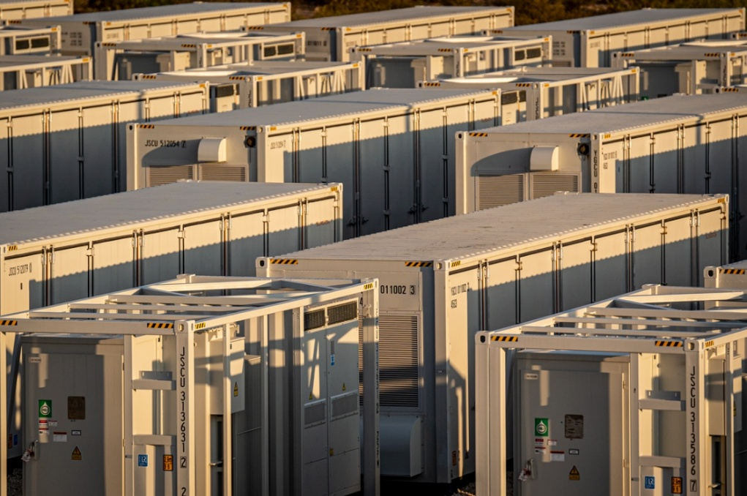
Other RFP Considerations to Meet MA policy goals
Goal – Insulate against new sources of pricing uncertainty
  Storage developers face extreme uncertainty at the federal level from tariffs, changes to tax credits (e.g., the ITC), and other policy fluctuations that could impact contract prices.
  DOER experienced this dynamic w/supply chain cost increases in prior Offshore Wind solicitations
  Recommendation – use already-existing price protection adjustment mechanisms from prior RFPs with minor modifications to capture tariff or ITC issues, warding against repeated re-bids or cancellations. RFP to request sufficient information about pricing assumptions to obtain apples-to-apples bids.
Goal – Emphasize NEW projects with multipliers equal to at least 1
  MA precedent – the CPS program currently acknowledges the value of adding new storage capacity in MA, applying a 0.1x CPEC modifier to existing storage resources, and those that already hold contracts (225 CMR 21.00, Sec. 21.05(6)(d)-(e)).
  Recommendation:
    Ensure that ratepayer dollars are awarded to resources that can produce at least 100% of expected CPECs by excluding resources with multipliers <1*; OR
    Award negative points to projects already in operation or construction at the time of bid, or additional points to new projects coming online after 2025
* 2024 Energy Act requires that existing resources can participate, but not that every existing resource is eligible to participate. Removing resources with a multiplier <1 that are unable to produce the full number of CPECs for ratepayers excludes resources that COD prior to 2019, but not those that COD between 2019-2025.
Resilience

